Slide 1

Analysis of Ticket Resolution Efficiency
Shivangi Shukla

Slide 2
Introduction
Analysis of ticket resolution efficiency, focusing on a dataset that captures various aspects of ticket management within an organization.
The primary purpose of this analysis is to gain insights into the efficiency of our ticket resolution process.
Address the following key questions:
What is the overall efficiency of our ticket resolution process?
How does efficiency vary across different teams?
Which types of tickets are taking the most time to resolve?

Slide 3
Need of Analysis
Improving Customer Satisfaction
Operational Efficiency
Identifying Trends and Patterns
Optimizing Workflows
Resource Training and Development
Proactive Issue Resolution
Decision-Making Support
Continuous Improvement

Slide 4
Data Cleaning
First check for NULL Value
Imputation of Numerical Columns:
numeric_columns = ['Assigned at', 'Initially assigned at', 'Solved at', 'Resolution time', 'First reply time in minutes within business hours', 'First resolution time in minutes', 'First resolution time in minutes within business hours', 'Full resolution time in minutes', 'Full resolution time in minutes within business hours', 'Requester wait time in minutes', 'Requester wait time in minutes within business hours’ ] for column in numeric_columns:
df[column].fillna(df[column].mean(), inplace=True)
Categorical Columns (Replace missing values )
df['Satisfaction Score'].fillna( 'Not Available’ , inplace=True)

Slide 5
Data Cleaning
Check Data Type
Check for duplicate Value
Save the data in new file

Slide 6
Data Analysis and Visualization
Efficiency Analysis - Average Resolution Time
Average Resolution Time: [calculated value] minutes
This key metric represents the mean time it takes to resolve a ticket, providing a central measure of efficiency for our support system.
average_resolution_time = df['Resolution time’].mean()
print(f"Average Resolution Time: {average_resolution_time} minutes\n”)
Why?
Understanding the average resolution time is crucial for assessing the overall efficiency of our support teams.
It serves as a benchmark to measure the effectiveness of our support system and identify potential areas for improvement.

Slide 7
Data Analysis and Visualization
Efficiency Analysis - Average Resolution Time by Group
Views on efficiency for different groups
group_efficiency = df.groupby('Group')['Resolution time’].mean().sort_values()
plt.figure(figsize=(10, 6))
sn.barplot(x=group_efficiency.index, y=group_efficiency.values)
plt.title('Average Resolution Time by Group’)
plt.xlabel('Group’)
plt.ylabel('Average Resolution Time (minutes)’)
plt.xticks(rotation=45, ha='right’)
plt.show()

Slide 8
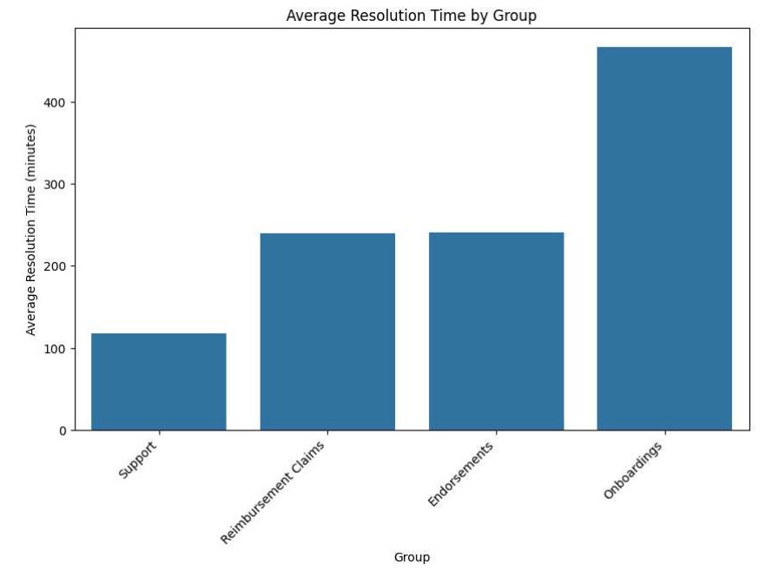
Data Analysis and Visualization

Slide 9
Data Analysis and Visualization
Ticket Type Analysis
Tickets taking the most time to resolve
ticket_types = df['Group’].unique() # Assuming there is a 'Type' column
type_resolution_time = {}
for ticket_type in ticket_types:
type_resolution_time[ticket_type] = df[df['Group'] == ticket_type]['Resolution time’].mean()

Slide 10
Data Analysis and Visualization
# Create a table
table = tabulate(type_resolution_df, headers='keys', tablefmt='pretty', showindex=False)
# Print the table
print("\nTicket Types and Average Resolution Time:”)
print(table)

Slide 11
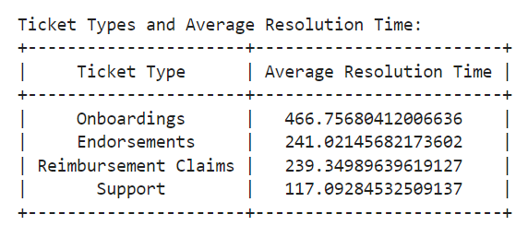
Data Analysis and Visualization
Table for ticket type Analysis

Slide 12
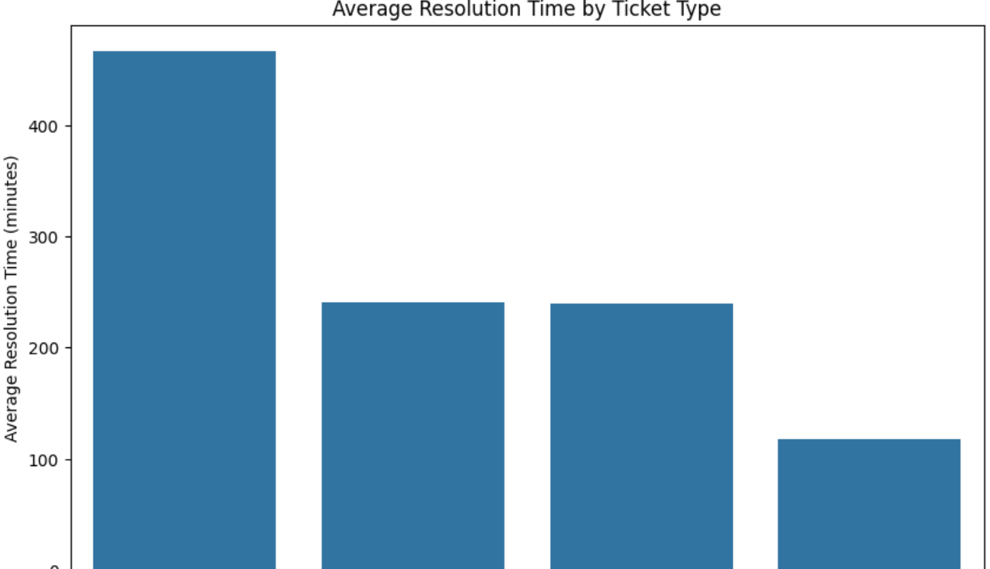
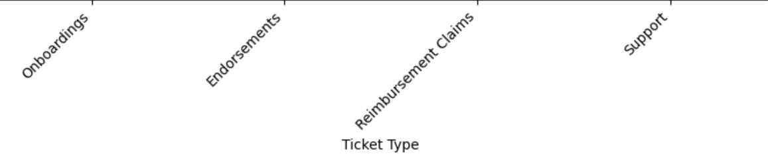
Data Analysis and Visualization
Bar chart for ticket type Analysis

Slide 13
CONCLUSION
Key Findings:
Average Resolution Time:
The overall average resolution time across all tickets is approximately 205.2462 minutes.
This metric provides a baseline for understanding the general efficiency of the support system.
Efficiency Across Groups:
After analyzing the average resolution time by group, it's evident that Onboardings (466.756804) >Endorsements (241.021457) > Reimbursement Claims (239.349896) > Support (117.092845)
Further investigation into the practices of high-performing groups may offer insights for optimization.
Ticket Type Analysis:
The ticket type with the highest average resolution time is Onboardings 466.756804.
Exploring the characteristics of this ticket type could uncover reasons for extended resolution times.

Slide 14
CONCLUSION
Next Steps:
Optimization Strategies:
Consider adopting best practices from high-performing groups to enhance overall efficiency.
Continuous Monitoring:
Implement ongoing monitoring and establish regular reviews and updates to ensure sustained improvements.
Feedback and Collaboration:
Encourage feedback from support teams to understand challenges and potential solutions.
Technology and Automation:
Explore the adoption of relevant technologies or automation tools to streamline processes and reduce resolution times.
Training and Skill Development:
Consider targeted training programs for teams facing challenges to enhance skills and efficiency

Slide 15


